Slide 1

STANDARDS:
SS6G1 Locate selected features of Latin America. a. Locate on a world and regional political-physical map: Amazon River, Amazon Rainforest, Caribbean Sea, Gulf of Mexico, Atlantic Ocean, Pacific Ocean, Panama Canal, Andes Mountains, Sierra Madre Mountains, and Atacama Desert.
b. Locate on a world and regional political-physical map the countries of Brazil, Chile, Colombia, Cuba, Mexico, and Panama.
© Brain Wrinkles

Slide 2
Politica1 & Physical Features
of Latin America
© Brain Wrinkles
PART ONE: Use a pen to label the following 6 countries on the map.
Brazil
Chile
Colombia
Cuba
Mexico
Panama
Next, use a marker to outline the political border of each country.
PART TWO: Draw and label the following 10 physical features on the map. *Make a map key to accompany your map. For example, use triangles to represent mountains.
Amazon River
Amazon Rainforest
Caribbean Sea
Gulf of Mexico
Pacific Ocean
Atlantic Ocean
Panama Canal
Andes Mountains
Sierra Madre Mountains
Atacama Desert

Slide 3
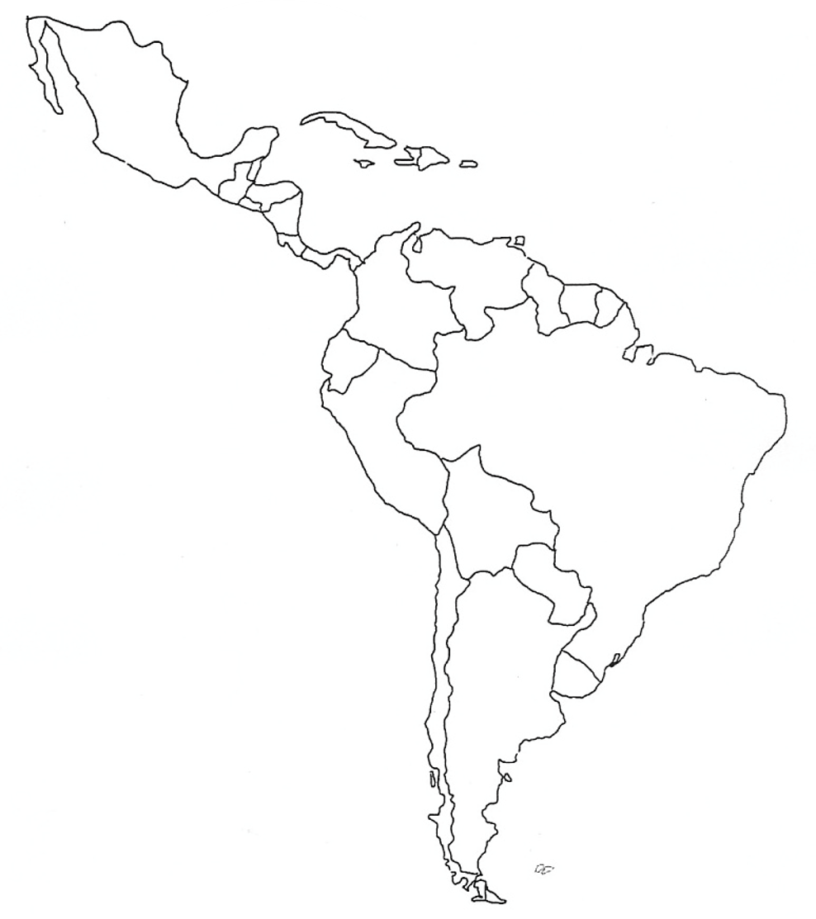
© Brain Wrinkles
Map Key
Politica1 & Physical Features
of Latin America

Slide 4
Geography
Latin America is located in the ________________________ .
It is a ________________________ that that includes most of the countries in the three regions of South America, Central America, and the Caribbean Islands.
Latin America is bordered by the ________________________ to the west and the ________________________ to the east.
Culture
Latin America is not a continent, but rather a ________________________ .
Latin American countries share a similar ________________________ .
The cultural element that unites the countries is language (________________________ ).
The region is called Latin America because these languages developed from the ________________________ language.
Regions
Latin America is divided into ________________________ :
1. ________________________ and Central America
2. The ________________________ Islands
3. ________________________
MEXICO & CENTRAL AMERICA
________________________(about as wide as the US)
________________________ dominate the region.
They are part of a ________________________ that extends from Canada, through the US, and all the way to the tip of South America.
There is a ________________________ in Mexico.
It lies between the Sierra Madre mountains and makes up ________________________ of the country’s area.
Central America is an ________________________ .
An isthmus is a ________________________ that has water on both sides and joins 2 larger bodies of water.
There are ________________________ in Central America, as a result, their soil is arable (fertile) and many people farm lands.
© Brain Wrinkles
Latin America’s Geography
CLOZE Notes 1

Slide 5
Gulf of Mexico
The Gulf of Mexico is a body of water that lies between ________________________ .
It is an “arm” of the ________________________ .
The Gulf of Mexico is bordered by the ________________________ , Mexico to the south, and Cuba to the east.
The ________________________ and Rio Grande are two major rivers that flow into the Gulf of Mexico.
Sierra Madre Mountains
The Sierra Madre Mountains are the main mountain system ________________________ .
The range contains ________________________ : the Sierra Madre Occidental in the west, the Sierra Madre Oriental in the east, and the Sierra Madre del Sur, which extends along the southern coast.
The Sierra Madre range contains some of the highest ________________________ in Latin America.
Panama Canal
The Panama Canal is a ________________________ across the isthmus of Panama in Central America.
It is a ________________________ that allows ships to travel between the Pacific and Atlantic oceans.
The Panama Canal is nearly ________________________ long.
It handles a large volume of ________________________ and enables ships to avoid traveling around South America, reducing their voyages by thousands of miles and many days.
It consists of artificially created lakes, channels, and a series of locks, or water-filled chambers, that ________________________ through the mountainous terrain of central Panama.
CARIBBEAN ISLANDS
The smaller islands are ________________________ (skeletons of tiny sea animals, a rock-like substance).
The larger islands are actually tops of ________________________ .
Examples: ________________________ , Jamaica
Caribbean Sea
The Caribbean Sea is ________________________ of the Atlantic Ocean.
It is located between Cuba and South America and ________________________ .
The Caribbean Sea is a ________________________ for Latin American countries.
It is also a ________________________ that is noted for its mild tropical climate and beautiful beaches.
© Brain Wrinkles
Latin America’s Geography
CLOZE Notes 2

Slide 6
SOUTH AMERICA
Andes Mountains
The Andes Mountains run 4,500 miles along the ________________________ of South America.
The Andes are the _______________________________________ in the world.
They rise at some points to 20,000 feet—the same height as ________________________ buildings stacked on top of each other!
Atacama Desert
The Atacama Desert is ________________________ at a high elevation in the Andes Mountains.
The desert’s average temperature is ________________________ .
Also, it’s one of the ________________________ with very little recorded rainfall annually.
Parts of the Atacama Desert have never had ________________________ .
Amazon Rainforest
The Amazon Rainforest spreads across much of ________________________ and covers 1/3rd of the continent.
It is the ________________________ in the world.
The Amazon Rainforest is home to over ________________________ , 1,000 different species of birds, and 2.5 million different kinds of insects.
The Amazon Rainforest’s plants produce ________________________ of the world’s oxygen supply.
It is often called the “________________________ ”.
Amazon River
The Amazon River is the ________________________ in the world (the 1st is the Nile River).
It carries the ________________________ of any river in the world.
The Amazon River stretches ________________________ (primarily across Brazil) to the Atlantic Ocean.
The Amazon River contains ________________________ in the world!
It serves as a ________________________ where it’s hard to build roads.
The Amazon also provides food and ________________________ .
Pacific Ocean
The Pacific Ocean is the ________________________ .
It touches the ________________________ of South America.
Atlantic Ocean
The Atlantic Ocean is the world’s ________________________ .
It is ________________________ of South America.
© Brain Wrinkles
Latin America’s Geography
CLOZE Notes 3

Slide 7

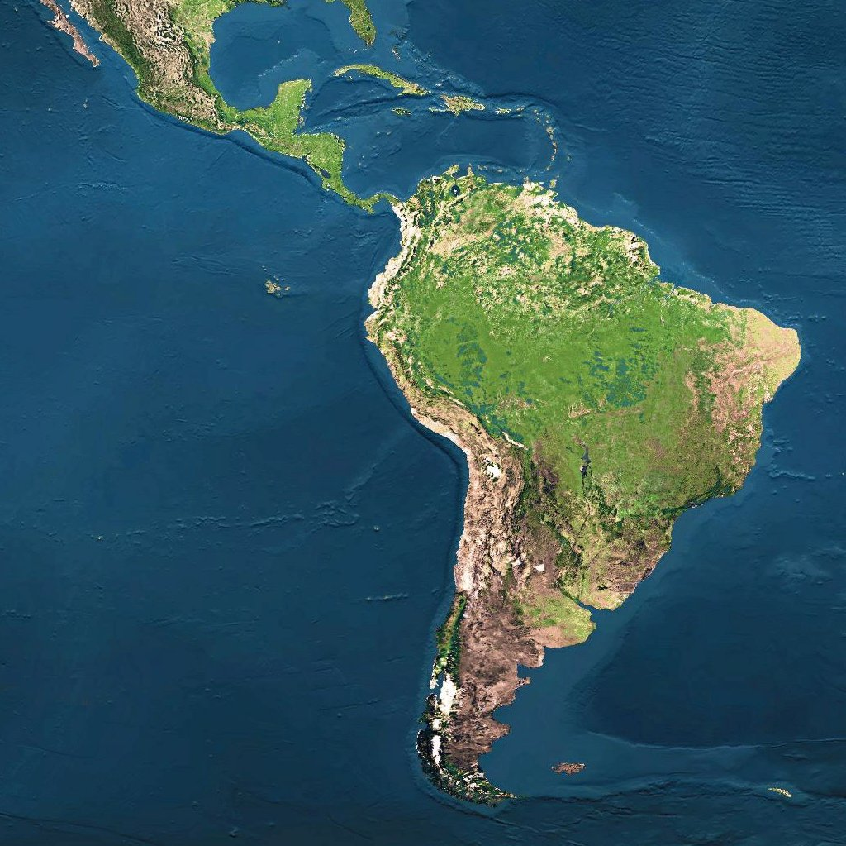

Geography of
Latin America
© Brain Wrinkles

Slide 8
Geography
Latin America is located in the Western Hemisphere.
It is a large land area that that includes most of the countries in the three regions of South America, Central America, and the Caribbean Islands.
Latin America is bordered by the Pacific Ocean to the west and the Atlantic Ocean to the east.
© Brain Wrinkles

Slide 9
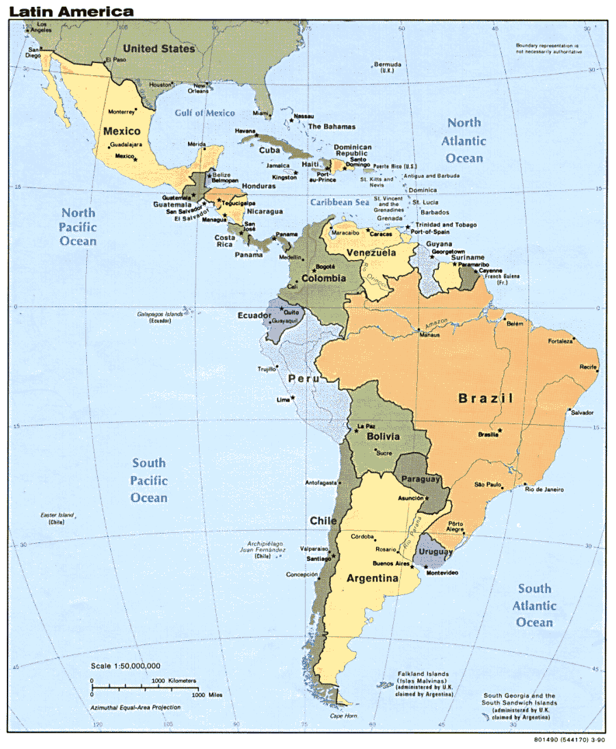
© Brain Wrinkles

Slide 10
Culture
Latin America is not a continent, but rather a cultural region.
Latin American countries share a similar culture and history.
The cultural element that unites the countries is language (Spanish and Portuguese).
The region is called Latin America because these languages developed from the Latin language.
© Brain Wrinkles

Slide 11
Regions
Latin America is divided into three regions:
Mexico and Central America
The Caribbean Islands
3. South America
© Brain Wrinkles

Slide 12
Mexico &
Central
America
© Brain Wrinkles

Slide 13
Mexico &
Central America
2,500 miles (about as wide as the US)
Mountains dominate the region.
  They are part of a huge system that extends from Canada, through the US, and all the way to the tip of South America.
There is a central plateau in Mexico.
  It lies between the Sierra Madre mountains and makes up more than half of the country’s area.
© Brain Wrinkles

Slide 14
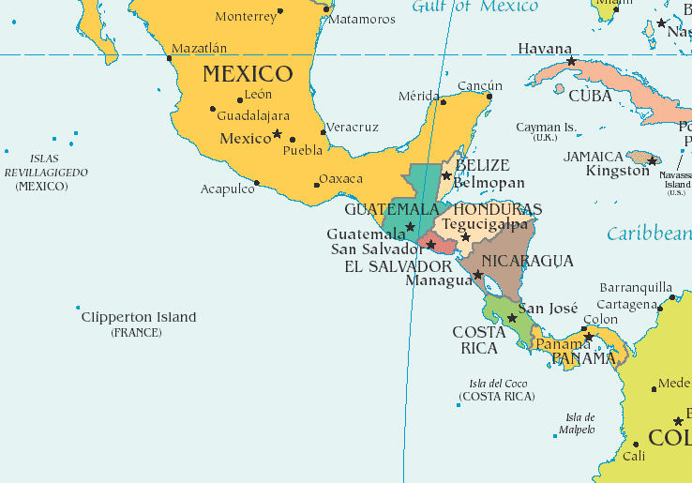
© Brain Wrinkles

Slide 15
Mexico &
Central America
Central America is an isthmus.
  An isthmus is a narrow strip of land that has water on both sides and joins 2 larger bodies of water.
There are many volcanoes in Central America, as a result, their soil is arable (fertile) and many people farm lands
© Brain Wrinkles

Slide 16
Gulf of Mexico
The Gulf of Mexico is a body of water that lies between Mexico and Florida.
It is an “arm” of the Atlantic Ocean.
The Gulf of Mexico is bordered by the United States to the north, Mexico to the south, and Cuba to the east.
The Mississippi River and Rio Grande are two major rivers that flow into the Gulf of Mexico.
© Brain Wrinkles

Slide 17
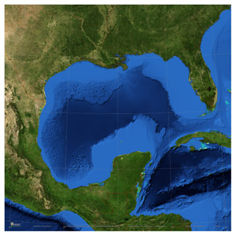
© Brain Wrinkles

Slide 18
Sierra Madre
Mountains
The Sierra Madre Mountains are the main mountain system in Mexico.
The range contains 3major chains: the Sierra Madre Occidental in the west, the Sierra Madre Oriental in the east, and the Sierra Madre del Sur, which extends along the southern coast.
The Sierra Madre range contains some of the highest mountains and volcanoes in Latin America.
© Brain Wrinkles

Slide 19
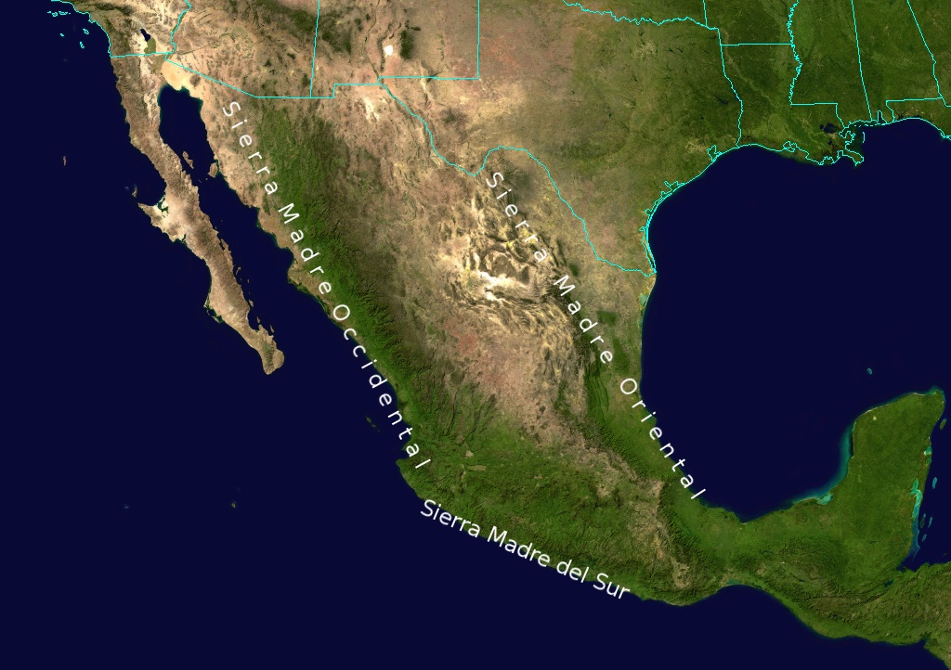
© Brain Wrinkles

Slide 20
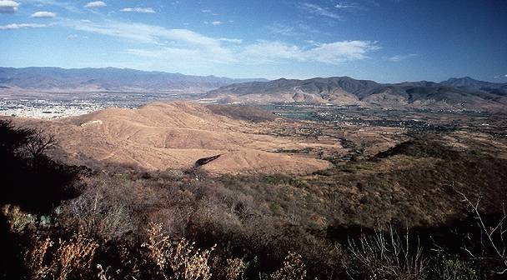
© Brain Wrinkles

Slide 21
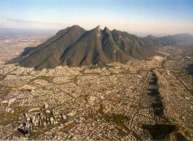
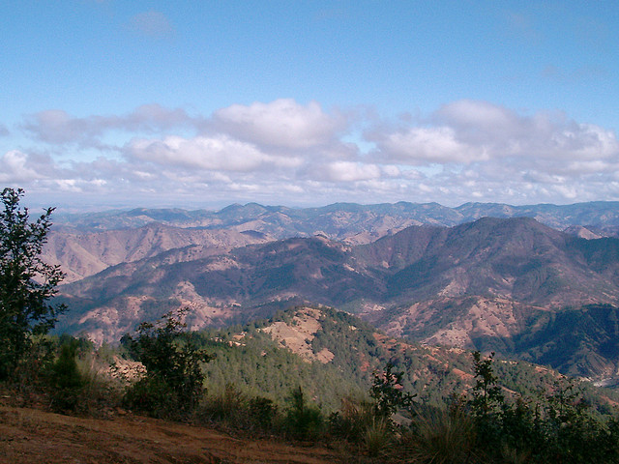
© Brain Wrinkles

Slide 22
Panama Canal
The Panama Canal is a man-made feature across the isthmus of Panama in Central America.
It is a major “shortcut” that allows ships to travel between the Pacific and Atlantic oceans.
The Panama Canal is nearly 50 miles long.
© Brain Wrinkles

Slide 23
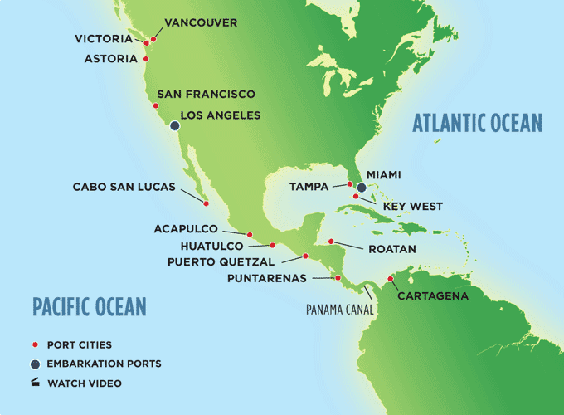
© Brain Wrinkles

Slide 24
Panama Canal
It handles a large volume of world shipping and enables ships to avoid traveling around South America, reducing their voyages by thousands of miles and many days.
It consists of artificially created lakes, channels, and a series of locks, or water-filled chambers, that raise and lower ships through the mountainous terrain of central Panama.
© Brain Wrinkles

Slide 25
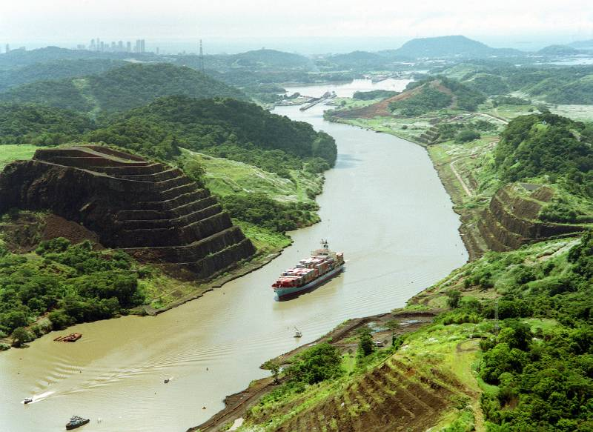
© Brain Wrinkles

Slide 26
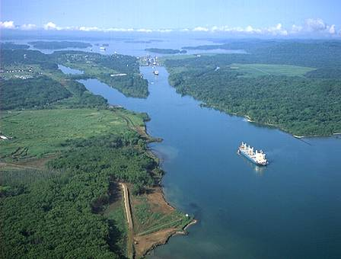
© Brain Wrinkles

Slide 27
Caribbean
Islands
© Brain Wrinkles

Slide 28
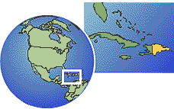
Caribbean Islands
The smaller islands are made of coral (skeletons of tiny sea animals, a rock-like substance).
The larger islands are actually tops of underwater mountains.
  Examples: Cuba, Jamaica
© Brain Wrinkles

Slide 29
© Brain Wrinkles

Slide 30
Caribbean
Sea
The Caribbean Sea is another arm of the Atlantic ocean.
It is located between Cuba and South America and surrounds the Caribbean islands.
© Brain Wrinkles

Slide 31
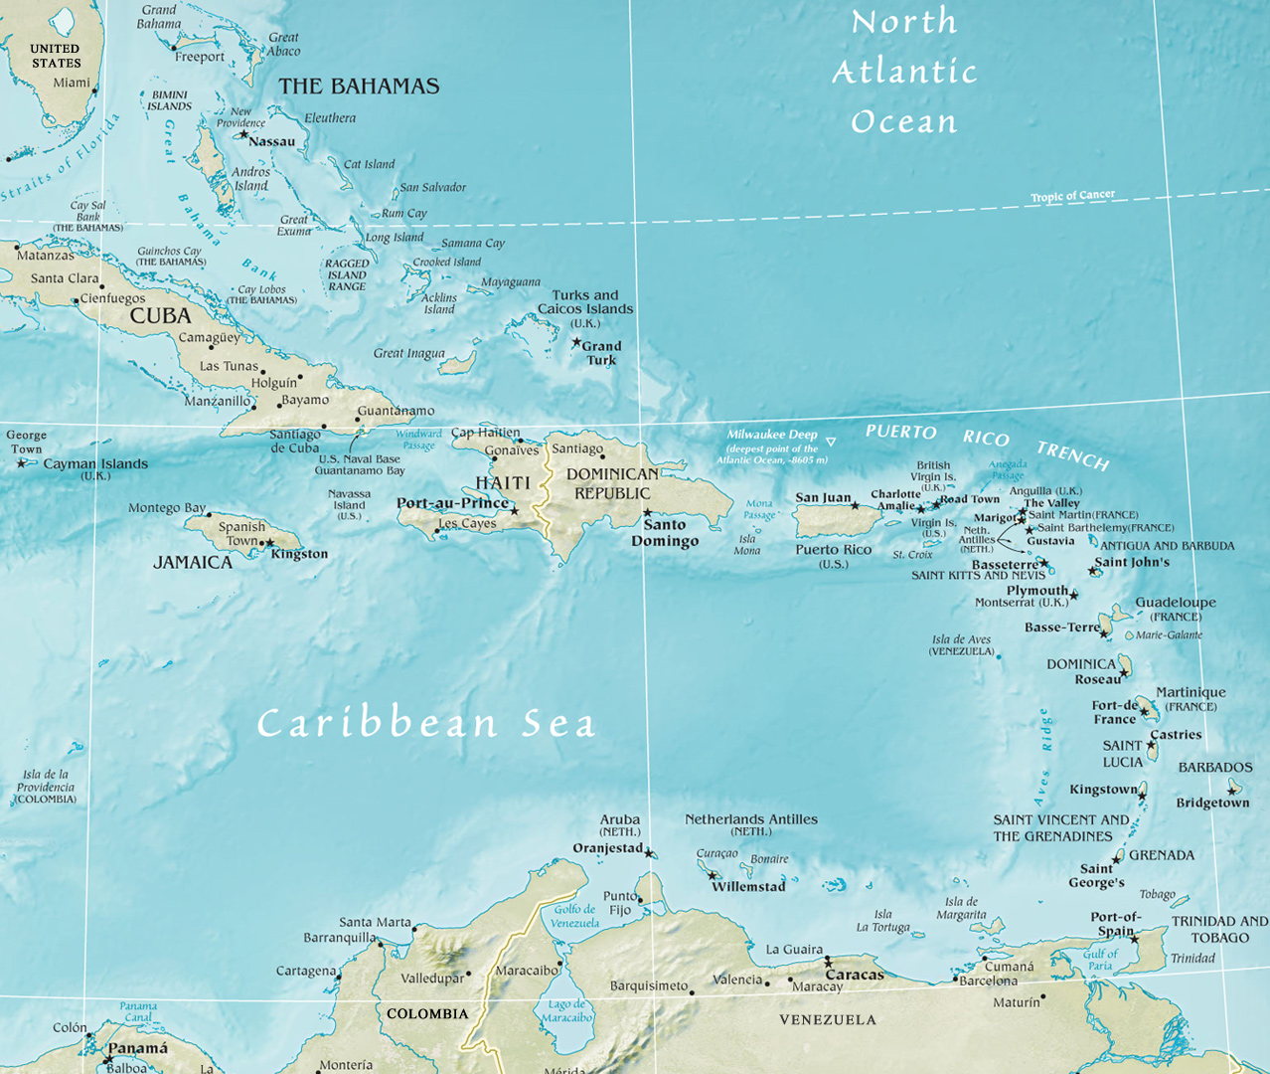
© Brain Wrinkles

Slide 32
Caribbean
Sea
The Caribbean Sea is a major trade route for Latin American countries.
It is also a popular tourist area that is noted for its mild tropical climate and beautiful beaches.
© Brain Wrinkles

Slide 33
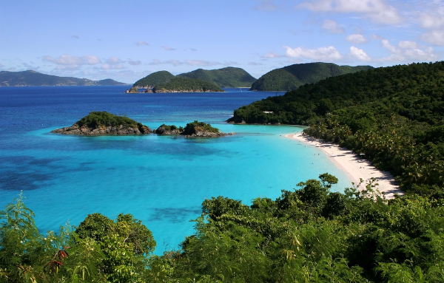
© Brain Wrinkles

Slide 34
South
America
© Brain Wrinkles

Slide 35
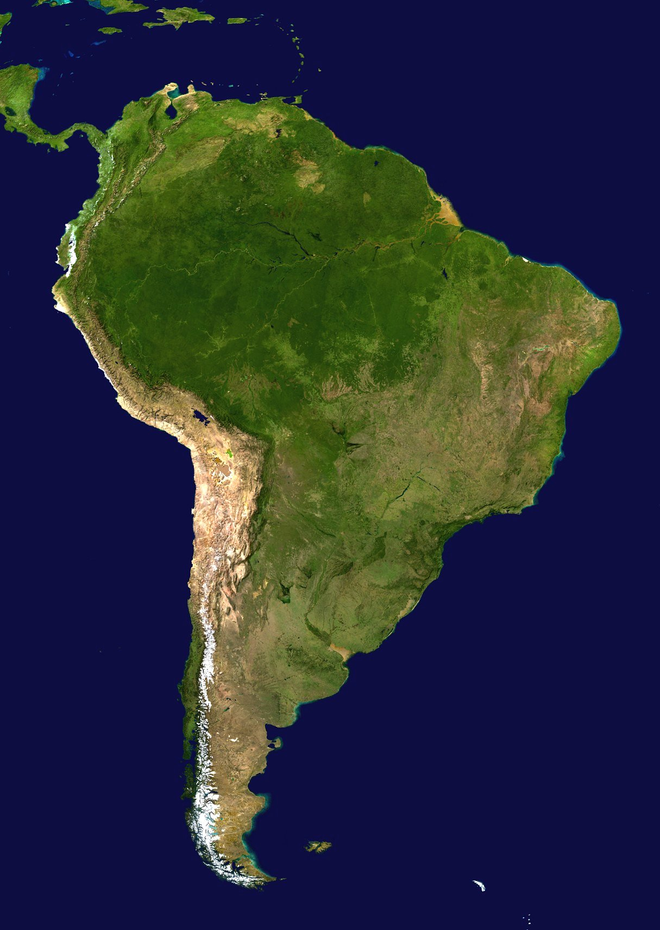
© Brain Wrinkles

Slide 36
Andes Mountains
The Andes Mountains run 4,500 miles along the west coast of South America.
The Andes are the longest continuous mountain range in the world.
They rise at some points to 20,000 feet—the same height as twenty 100 story buildings stacked on top of each other!
© Brain Wrinkles

Slide 37
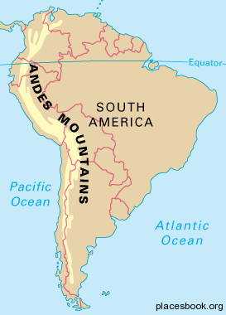
© Brain Wrinkles

Slide 38
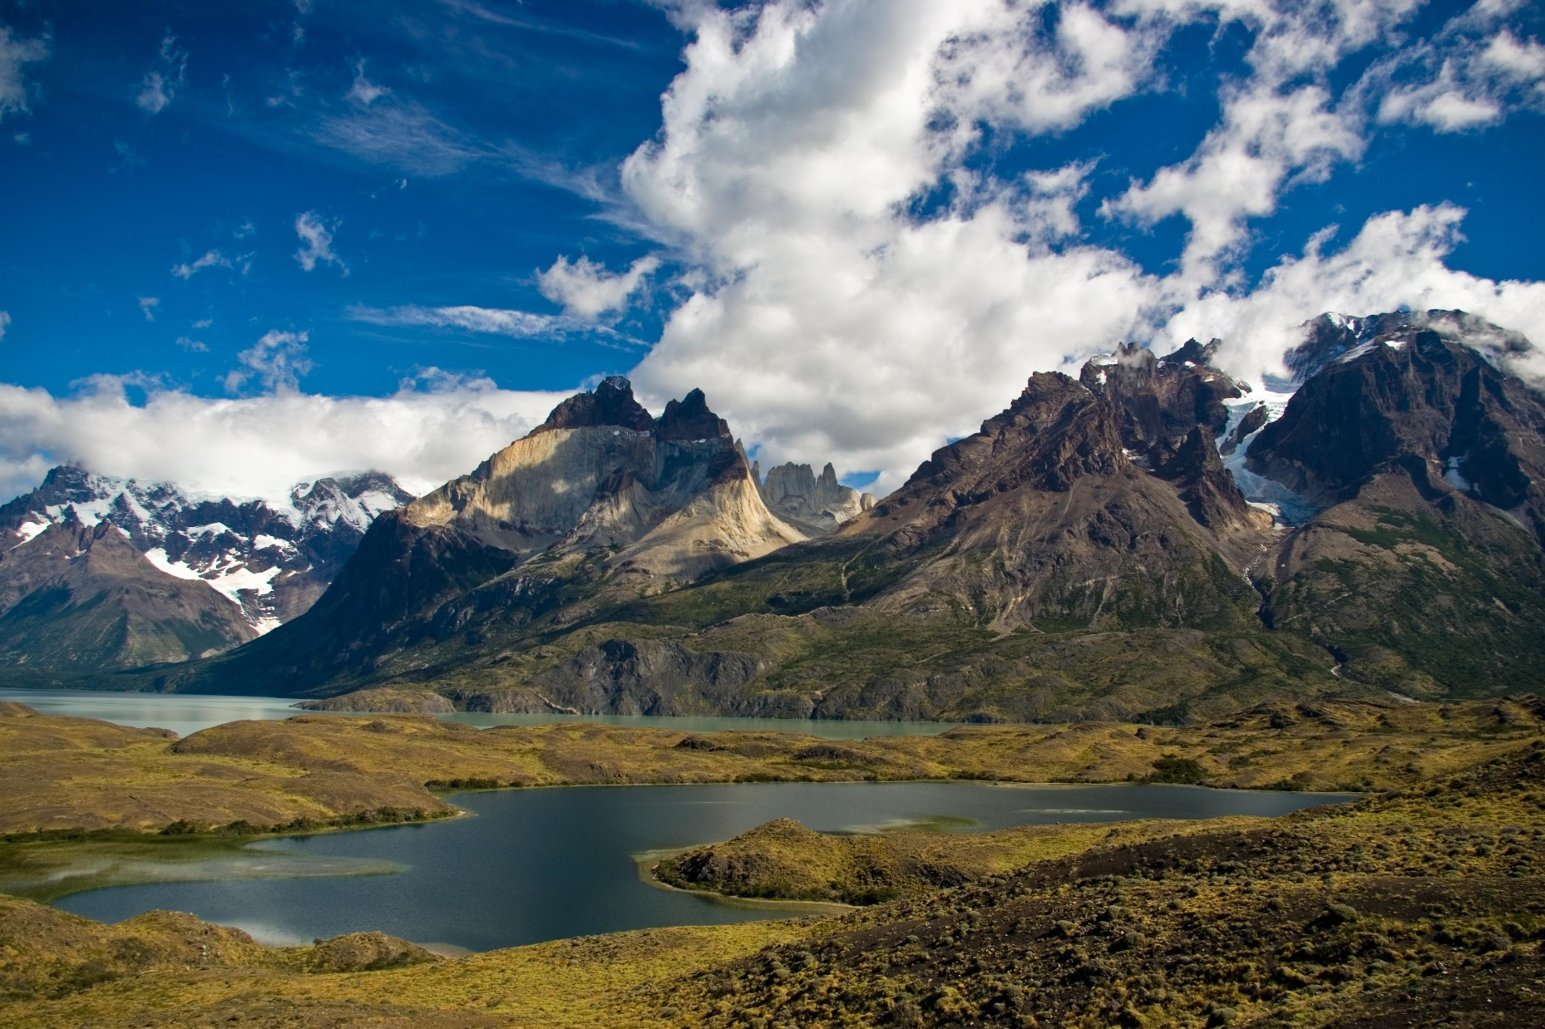
© Brain Wrinkles

Slide 39
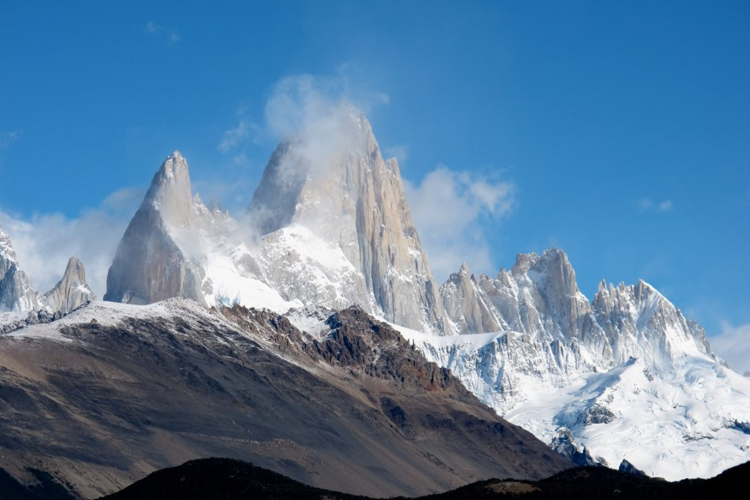
© Brain Wrinkles

Slide 40
Atacama Desert
The Atacama Desert is located in Chile at a high elevation in the Andes Mountains.
The desert’s average temperature is pretty chilly.
Also, it’s one of the driest places on earth with very little recorded rainfall annually.
Parts of the Atacama Desert have never had any rain.
© Brain Wrinkles

Slide 41
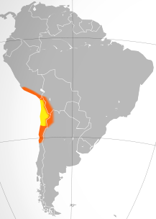
© Brain Wrinkles

Slide 42
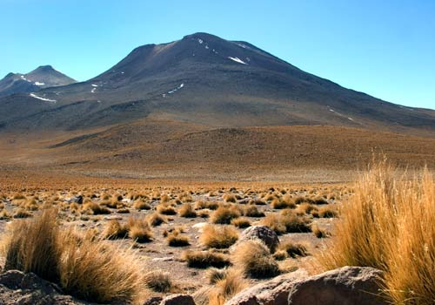
© Brain Wrinkles

Slide 43
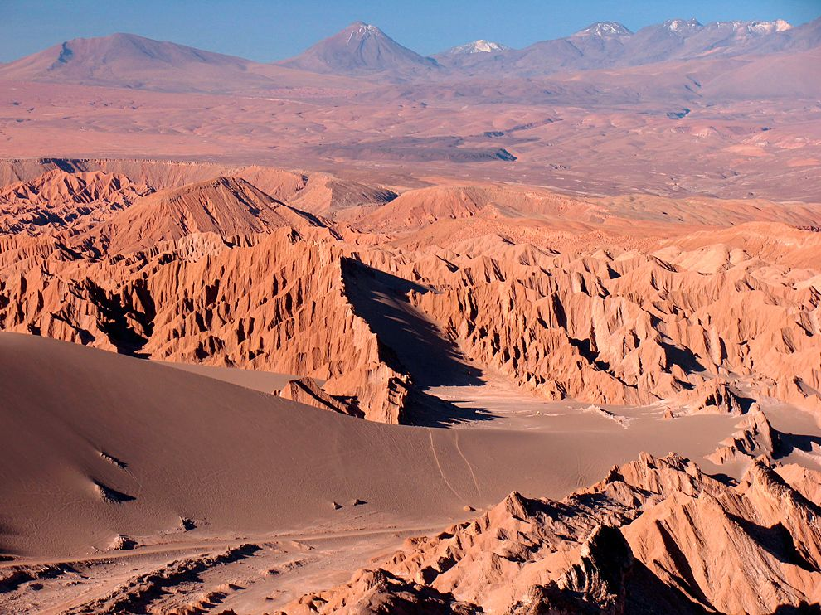
© Brain Wrinkles

Slide 44
Amazon Rainforest
The Amazon Rainforest spreads across much of northern South America and covers 1/3rd of the continent.
It is the largest tropical rainforest in the world.
The Amazon Rainforest is home to over 40,000 plants, 1,000 different species of birds, and 2.5 million different kinds of insects.
© Brain Wrinkles

Slide 45
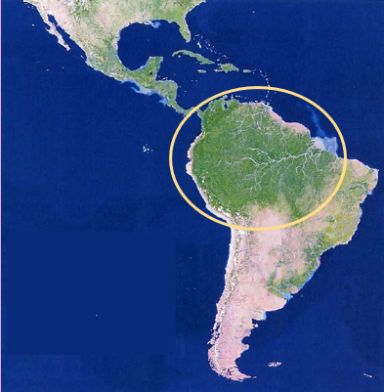
© Brain Wrinkles

Slide 46
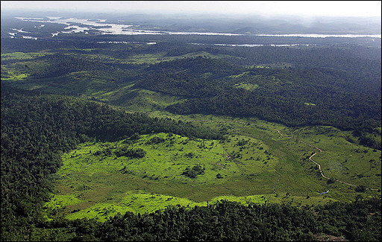
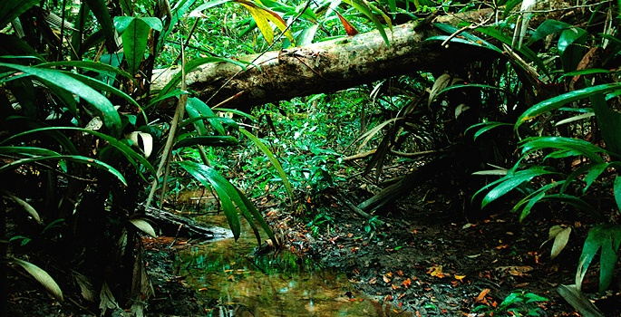
© Brain Wrinkles

Slide 47
Amazon Rainforest
The Amazon Rainforest’s plants produce more than 20% of the world’s oxygen supply.
It is often called the “lungs of the Earth”.
© Brain Wrinkles

Slide 48
Amazon River
The Amazon River is the 2nd longest river in the world (the 1st is the Nile River).
It carries the greatest volume of water of any river in the world.
The Amazon River stretches 4,000 miles (primarily across Brazil) to the Atlantic Ocean.
© Brain Wrinkles

Slide 49
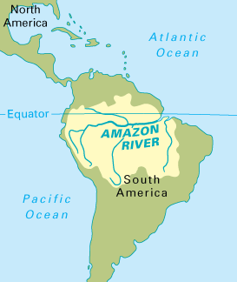
© Brain Wrinkles

Slide 50
Amazon River
The Amazon River contains 20% of all fresh water in the world!
It serves as a natural highway where it’s hard to build roads.
The Amazon also provides food and hydroelectric power.
© Brain Wrinkles

Slide 51
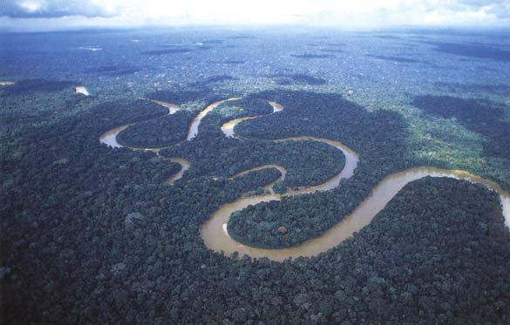
© Brain Wrinkles

Slide 52
Pacific Ocean
The Pacific Ocean is the world’s largest ocean.
It touches the western coast of South America.
© Brain Wrinkles

Slide 53
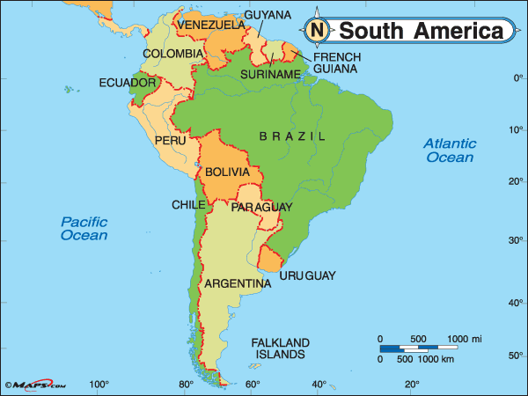
© Brain Wrinkles

Slide 54
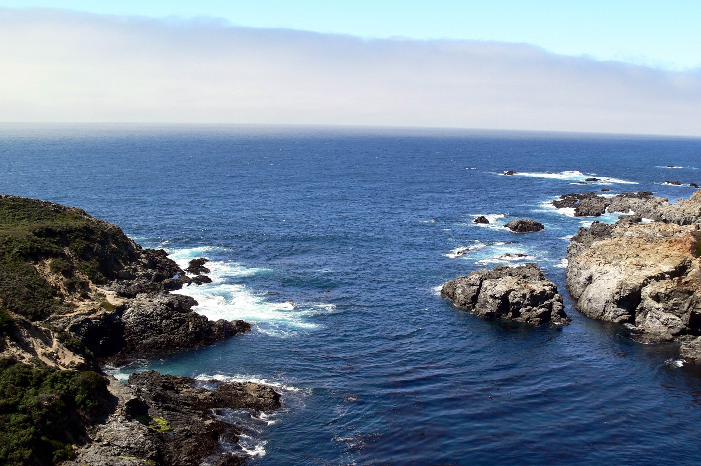
© Brain Wrinkles

Slide 55
Atlantic Ocean
The Atlantic Ocean is the world’s second-largest ocean.
It is located east of South America.
© Brain Wrinkles

Slide 56
© Brain Wrinkles

Slide 57
What:
Where:
Illustration:
What:
Where:
Illustration:
What:
Where:
Illustration:
© Brain Wrinkles
Andes Mountains
Panama Canal
Gulf of Mexico
Directions: Complete the chart below with information that you learn during the presentation. If time allows, color your illustrations.
Latin America’s Physical Features
What:
Where:
Illustration:
What:
Where:
Illustration:
What:
Where:
Illustration:
Atacama Desert
Caribbean Sea
Sierra Madre Mountains

Slide 58
What:
Where:
Illustration:
What:
Where:
Illustration:
© Brain Wrinkles
Pacific Ocean
Amazon Rainforest
Directions: Complete the chart below with information that you learn during the presentation. If time allows, color your illustrations.
Latin America’s Physical Features
What:
Where:
Illustration:
What:
Where:
Illustration:
Atlantic Ocean
Amazon River

Slide 59
Latin American Landforms
Directions: Write the physical features below where they are located in Latin America.
Amazon River
Caribbean Sea
Gulf of Mexico
Pacific Ocean
Panama Canal
Andes Mountain
Sierra Madre Mountains
Atacama Desert
Amazon Rainforest
Atlantic Ocean
Mexico & Central America | Caribbean | South America
© Brain Wrinkles

